Slide 1





Stock Market Forecast
Team : Karthikeyan M (karthikeyan8924@mountzion.ac.in)
Guide: Raja P Master Trainer , Edunet Foundations
Disclaimer: The content is curated for educational purposes only.
Notes:
Slides: Prepare a short slide deck (10-12 slides) summarizing the project objectives, methodology, and key results.

Slide 2
OUTLINE
Abstract of the Project
Problem Statement
Proposed Solution
System Architecture
Live Demo of the Project
Embedded Video of Project
Conclusion
Future Scope

Slide 3
Abstract
Project Goal: Forecast stock market trends using linear regression to predict stock prices.
Data Source: Historical pricing data from the NIFTY 50 index.
Data Processing:
Load and structure data in a Pandas DataFrame.
Use the 10-day exponential moving average (EMA) as a key technical indicator.
Model Development:
Train a simple linear regression model using EMA and other features to predict future closing prices.
Performance Evaluation:
Analyze accuracy by comparing actual and predicted values.
Plot results and calculate error magnitudes to assess predictive power.
Insights and Applications:
Gauge the model’s potential for real-world stock forecasting.
Identify improvement areas to enhance prediction accuracy.

Slide 4
Problem Statement
Accurately forecasting stock prices is a significant challenge due to the inherent volatility and complexity of financial markets. Investors seek reliable models that can predict future stock movements to make informed decisions, yet existing models often struggle to achieve high accuracy. This project addresses this challenge by developing a stock price prediction model using linear regression, with a focus on the NIFTY 50 index. The model leverages historical price data and technical indicators, specifically the 10-day Exponential Moving Average, to predict closing prices. By assessing the model's accuracy and analyzing prediction errors, this project aims to provide insights into the potential and limitations of linear regression for stock market forecasting.

Slide 5
Proposed Solution
Objective: Predict stock prices using a linear regression model, focusing on NIFTY 50 index historical data.
Data Preparation:
Load and preprocess historical stock price data.
Compute technical indicators, notably the 10-day Exponential Moving Average (EMA).
Model Training:
Use the 10-day EMA as a key feature to train the linear regression model.
Identify patterns influencing stock price trends.
Evaluation Metrics:
Compare actual and predicted closing prices.
Calculate error metrics to assess model accuracy.
Outcomes and Potential:
Develop a straightforward yet effective forecasting model.
Explore opportunities for further refinement through additional indicators or model adjustments.

Slide 6
System Architecture
Data Loading and Preprocessing:
Load historical stock market data into a Pandas DataFrame.
Clean and preprocess data for accuracy and consistency.
Feature Engineering:
Calculate technical indicators, including the 10-day Exponential Moving Average (EMA).
Add these indicators as features for the model.
Data Splitting:
Split data into training and testing sets to validate the model.
Model Training:
Train a linear regression model using indicators like EMA to predict closing prices.
Performance Evaluation:
Compare predicted and actual prices.
Use error metrics (e.g., Mean Absolute Error (MAE), Root Mean Squared Error (RMSE)) to assess accuracy.

Slide 7
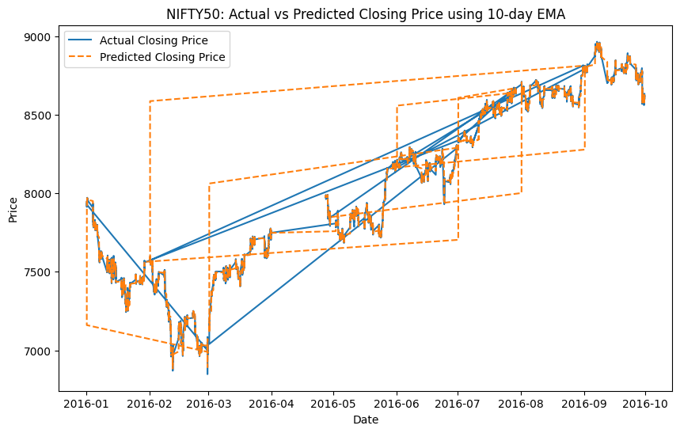
Live Demo of Project

Slide 8
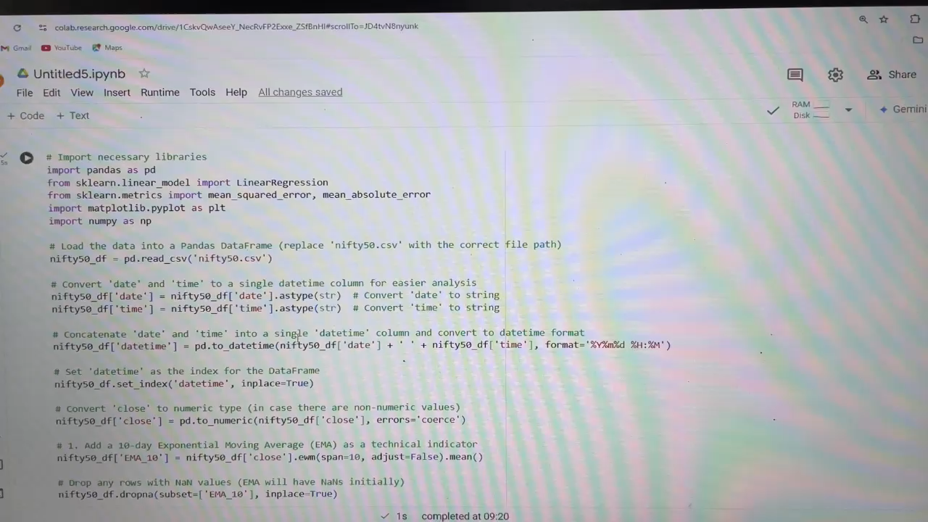
Video of Project Demo

Slide 9
Conclusion
Project Overview:
Developed a stock market forecasting model using historical pricing data and linear regression.
Key Features:
Incorporated the 10-day Exponential Moving Average (EMA) and other technical indicators as predictors to
forecast closing prices.
Model Insights:
Linear regression provided a straightforward approach, offering useful insights into stock price trends.
Limitations were noted in capturing short-term price fluctuations due to stock market volatility and noise.
Error Analysis:
Accuracy challenges were reflected in the error metrics, highlighting areas for improvement.
Future Enhancements:
Explore advanced models like machine learning algorithms for time-series data.
Consider additional factors, such as macroeconomic indicators, to improve predictive accuracy.

Slide 10
Future Scope
Current Model:
Built a foundational stock price forecasting model using linear regression and technical indicators.
Future Enhancements:
Integrate advanced machine learning techniques, like LSTM networks, for improved time-series forecasting.
Expand features by adding more technical and macroeconomic indicators to increase model responsiveness.
Potential Approaches:
Explore ensemble models or hybrid approaches to minimize forecasting errors.
Project Significance:
Demonstrates a pathway to refine stock market predictions, paving the way for more reliable financial
decision-making with advanced methods.

Slide 11
Thank you!
Notes:
thank you very much for joining this PPT, keep learning.
11

